Slide 1







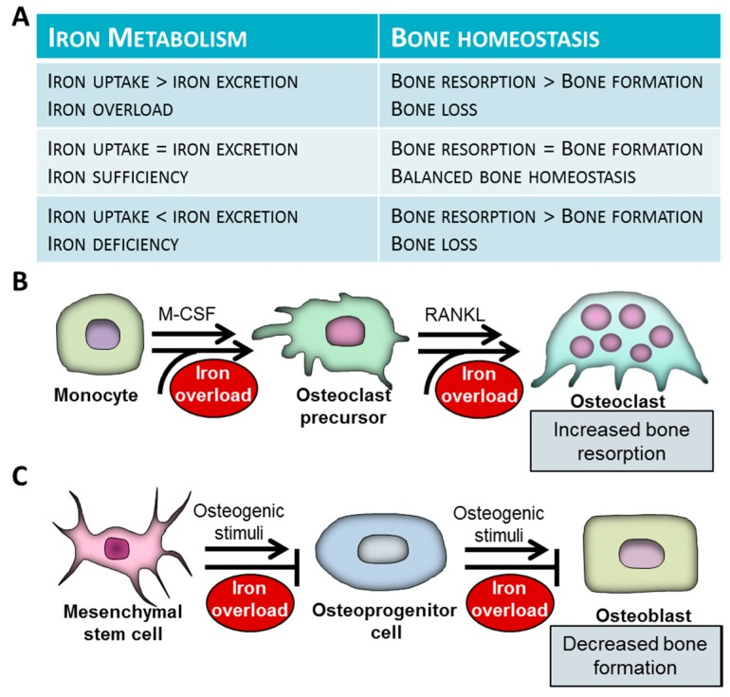
Osteoporosis: Gene interaction between
haptoglobin and HFE polymorphisms
Laura Aguiar^{1,2,3}, Joana Ferreira^{1,2,3}, Cristina Monteiro⁴, Maria José Laires³, Fátima Batista⁴,
Mário Rui Mascarenhas^{3,5}, Ângela Inácio^{1,2,3}, Paula Faustino^{3,6}, Manuel Bicho^{1,2,3}
¹Instituto de Investigação Científica Bento da Rocha Cabral, Lisbon, Portugal
²Laboratório de Genética, Faculdade de Medicina da Universidade de Lisboa, Lisbon, Portugal
³Instituto de Saúde Ambiental, Faculdade de Medicina da Universidade de Lisboa, Lisbon, Portugal
⁴Centro Interdisciplinar de Estudo da Performance Humana, Faculdade de Motricidade Humana da Universidade de Lisboa, Lisbon, Portugal
⁵Clínica de Endocrinologia, Diabetes e Metabolismo de Lisboa, Lisbon, Portugal
⁶Departamento de Genética Humana, Instituto Nacional de Saúde Doutor Ricardo Jorge, Lisbon, Portugal
Introduction
Osteoporosis is a common metabolic bone disease characterized by reduced bone mass and increased risk of fragility fractures. The pathogenesis of this disease is complex and influenced by multiple risk factors, where genetic factors play an important role (1). Osteoporosis and iron metabolism have an important relationship. Iron overload suppresses osteoblast formation and stimulate osteoclast resorption of bone, suggesting that polymorphisms in genes affecting iron homeostasis can increase the susceptibility for the development of osteoporosis (2,3) (Figure 1).
In the present study, we aimed to analyse the epistatic relationship between two iron metabolism related genes - haptoglobin (Hp) and HFE – in osteoporosis.
Materials and Methods
We studied 313 patients with osteoporosis (47 males and 266 females) from Clínica de Endocrinologia, Diabetes e Metabolismo de Lisboa and from Centro Interdisciplinar de Estudo da Performance Humana, Faculdade de Motricidade Humana da Universidade de Lisboa. Their average age was 63.96 ± 10.37 years and their body mass index (BMI) was 27.17 ± 4.41 Kg/m². A total of 450 controls with normal BMD from the same institutions were used (89 males and 361 females), with an average age of 49.88 ± 12.67 years and a BMI of 30.26 ± 5.36 Kg/m². Haptoglobin phenotype was determined by polyacrylamide gel electrophoresis (PAGE) and HFE polymorphisms (H63D and C282Y) were evaluated by PCR-RFLP. All statistical tests were performed with SPSS 24.0 software.
Figure 1 - The effect of iron overload on differentiation and function of osteoblasts and osteoclasts. M-CSF - macrophage colony-stimulating factor; RANKL - receptor activator of nuclear factor κB ligand (Adapted from reference 3).
We compared the patients and the control group for age, gender and body mass index (BMI), to avoid possible bias. Age was higher in patients with osteoporosis (p<0.001) and BMI was lower in these patients (p<0.001). Regarding gender, there were no statistically significant difference (p=0.091) between the two groups (Table 1).
Results show no significant differences between the two populations concerning distributions of Hp phenotypes or H63D or C282Y genotypes (p=0.724, p=0.931 and p=0.259, respectively; Table 2). However, regarding the interaction Hp-H63D, a significant difference was found between the two groups. Carriers of Hp 2.2 phenotype and H63D HH genotype, in combination, are at increased risk for developing osteoporosis even after adjusting for age and BMI [p=0.049; OR (95% CI) = 2.509 (1.003-6.279)]. These results are shown in Table 3.
Results
Table 1 – Comparison of age, gender and BMI between patients and controls
Characteristic | Controls | Patients with osteoporosis | p-value
Age, years | 449 (51.6, 19.1-81.6) | 313 (63.9, 27.8-85.0) | <0.001¹
Gender |  |  | 0.091²
female | 361 (80.2) | 266 (85.0)
male | 89 (19.8) | 47 (15.0)
BMI, kg/m² | 449 (29.8, 17.8-49.2) | 313 (26.8, 17.3-43.6) | <0.001¹
¹Mann-Whitney test, n (median, min-max) ²Pearson’s χ² test, n (%)
Table 2 - Comparison of distributions of Hp phenotypes and HFE genotypes between patients and controls
 | Controls | Patients with osteoporosis | p-value
Hp phenotype |  |  | 0.724¹
2.2 | 108 (42.2) | 79 (43.9)
2.1/1.1 | 148 (57.8) | 101 (56.1)
H63D |  |  | 0.931¹
HH | 48 (68.6) | 87 (68.0)
HD/DD | 22 (31.4) | 41 (32.0)
C282Y |  |  | 0.259²
CC | 65 (90.3) | 123 (94.6)
CY/YY | 7 (9.7) | 7 (5.4)
¹Pearson’s χ² test, n (%) ²Fisher's exact test, n (%)
Table 3 – Comparison of the distribution of the combined genotype Hp2.2-HH between patients and controls
 |  |  |  |  | Adjusted²
 | Controls | Patients with osteoporosis | p-value¹ | OR (95% CI) | p-value | OR (95% CI)
Interaction Hp-H63D |  |  | 0.016 | 2.747 (1.186-6.365) | 0.049 | 2.509 (1.003-6.279)
Hp 2.2–HH presence | 9 (18.4) | 34 (38.2)
Hp 2.2–HH absence | 40 (81.6) | 55 (61.8)
¹Pearson’s χ² test, n (%) ²Binary logistic regression, adjusted for age and BMI
Conclusion
In conclusion, a signiﬁcant epistatic interaction was detected between haptoglobin and HFE genes in osteoporosis, where Hp 2.2 in combination with H63D HH genotype appear to increase the risk for developing osteoporosis. Since these genes are related to iron metabolism, the results of this study reinforce an important action of this metabolism in the development of osteoporosis.
References
Ralston, S. H., & de Crombrugghe, B. (2006). Genetic regulation of bone mass and susceptibility to osteoporosis. Genes & development, 20(18), 2492-2506.
Che, J., Yang, J., Zhao, B., Zhang, G., Wang, L., Peng, S., & Shang, P. (2019). The Effect of Abnormal Iron Metabolism on Osteoporosis. Biological trace element research, 1-13.
Balogh, E., Paragh, G., & Jeney, V. (2018). Influence of iron on bone homeostasis. Pharmaceuticals, 11(4), 107.
Financial support: The study was self-funded by the institutions involved;
Conflicts of Interest: The authors declare that there is no conﬂict of interest

