Slide 1






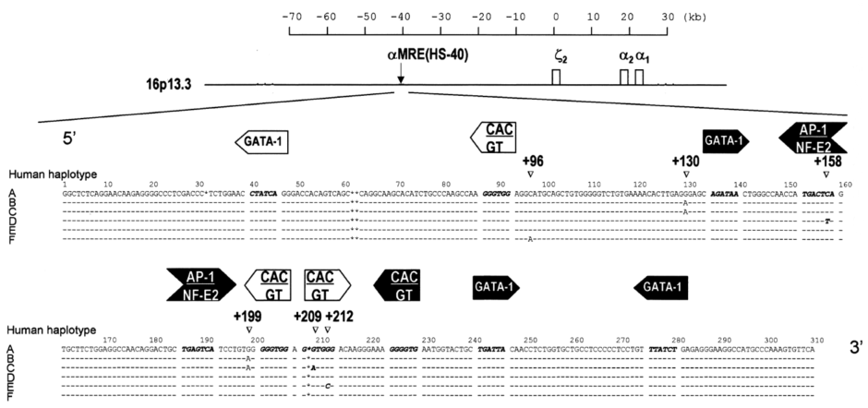
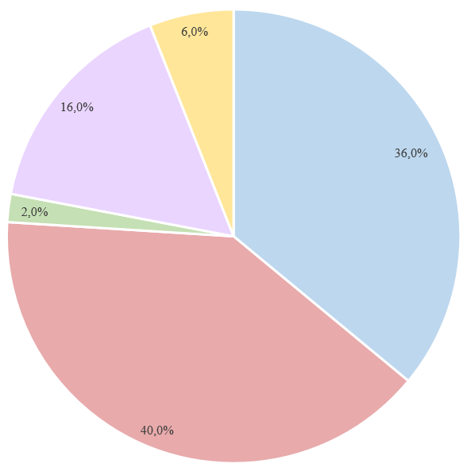
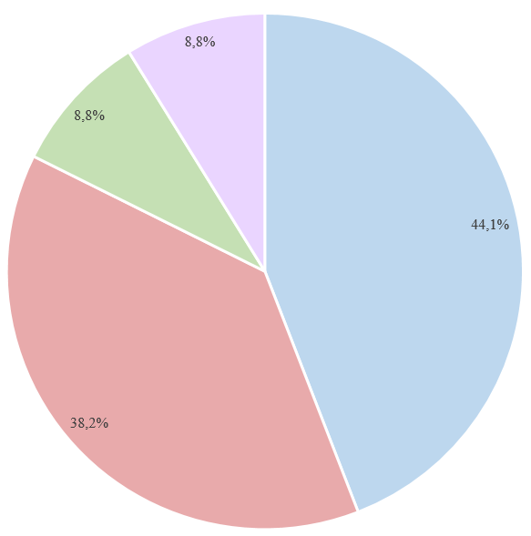
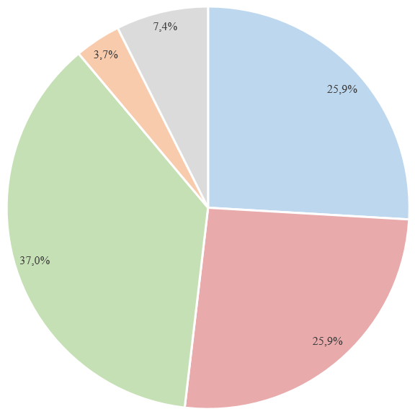


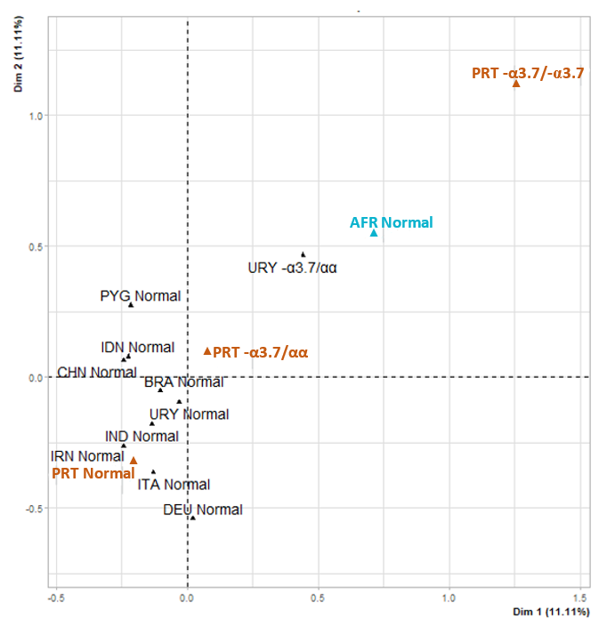
Ancestry of the major long-range regulatory site of the α-globin genes in the Portuguese population with the common 3.7kb α-thalassemia deletion
Rita Pena¹, Pedro Lopes¹, Gisela Gaspar², Armandina Miranda², Paula Faustino^{1,3}
1. Departamento de Genética Humana, Instituto Nacional de Saúde Doutor Ricardo Jorge, Lisboa;
2. Departamento de Promoção da Saúde e Prevenção de Doenças Não Transmissíveis, Instituto Nacional de Saúde Doutor Ricardo Jorge, Lisboa;
3. Instituto de Saúde Ambiental, Faculdade de Medicina, Lisboa; Portugal.
Introduction
The α-major regulatory element (α-MRE), also known as HS-40, is a 350 bp enhancer located upstream of the α-globin gene cluster and has a crucial role in the long-range regulation of α-globin gene expression ^{[1,2]}. This element is genetically polymorphic and six haplotypes (A to F) have been identified in different populations (Figure 1). Haplotype D was primarily described in African populations and is nearly absent in other populations ^{[3]}.
In Portugal, the principal molecular basis of α-thalassemia is the 3.7kb deletion that removes one α-globin gene per allele ^{[4]}.
Aims
Identification of the α-MRE haplotypes associated with the common 3.7kb α-thalassemia deletion (-α3.7del) in the Portuguese population, and investigation of its ancestry.
Figure 1 - Schematic representation of the α-globin gene cluster and the upstream regulatory region. Functional genes ζ₂, α₂ and α₁ are represented as blue boxes and the major regulatory element or HS-40 is indicated by a black arrow. The human HS-40 sequence is shown below the α-cluster. The small bars represent sequence similarity, while the asterisks represent gaps in comparison with the human sequence. The position and direction of the binding sites for nuclear factors GATA-1, AP-1/NF-E2, and the CAC/GT binding factors are indicated as arrows. Dark arrows represent the binding sites occupied in vivo; white arrows represent binding sites that are not occupied in vivo. The human HS-40 haplotypes are indicated next to each sequence as A to F. The numbers indicate the position of the polymorphic sites in the HS-40 sequence. Adapted from [3].
Materials and Methods
Results and Discussion
We searched for the -α3.7del in 111 selected Portuguese individuals by Gap-PCR. In addition, a DNA fragment containing the α-MRE was amplified by conventional PCR and Sanger sequenced. Statistical analysis was performed using R software.
111 Portuguese individuals
50 with the αα/αα genotype
(Group I)
34 with the -α^{3.7}/αα genotype
(Group II)
27 with the -α^{3.7}/-α^{3.7} genotype
(Group III)
Table 1 - HS-40 genotypes in the Portuguese population without the α-thalassemia 3.7kb deletion (αα/αα), with the deletion in heterozygosity (-α^{3.7}/αα) and in homozygosity (-α^{3.7}/-α^{3.7})
α-globin genotype | α-MRE genotypes
 | AA n (%) | AB n (%) | AD n (%) | BB n (%) | BC n (%) | BD n (%) | DD n (%)
αα/αα (n = 50) | 18 (36.0) | 20 (40.0) | 1 (2.0) | 8 (16.0) | 3 (6.0) | 0 (0.0) | 0 (0.0)
-α^{3.7}/αα (n = 34) | 15 (44.1) | 13 (38.2) | 3 (8.8) | 3 (8.8) | 0 (0.0) | 0 (0.0) | 0 (0.0)
-α^{3.7}/-α^{3.7} (n = 27) | 7 (25.9) | 7 (25.9) | 10 (37.0) | 0 (0.0) | 0 (0.0) | 1 (3.7) | 2 (7.4)
Total (n = 111) | 40 (36.0) | 40 (36.0) | 14 (12.6) | 11 (10.0) | 3 (2.7) | 1 (0.9) | 2 (1.8)
n= number of individuals
Figure 2 – Graphic distribution of the different HS-40 genotype frequencies (in %) according to the corresponding α-globin genotypes of the studied Portuguese individuals. (I) group without the 3.7kb α-thalassemia deletion (αα/αα); (II) group with the 3.7kb deletion in heterozygosity (-α^{3.7}/αα); (III) group with the 3.7kb deletion in homozygosity (-α^{3.7}/-α^{3.7}).
71.4% of AD individuals are homozygous for the -α3.7del
Genotype AD is the most common in individuals with the -α^{3.7}/-α^{3.7} genotype
Portuguese individuals without the -α3.7del
Grouped with other European populations
Portuguese individuals
with the -α3.7del
More closely related to the African population
Table 2 - HS-40 haplotypes in the Portuguese population without the α-thalassemia 3.7kb deletion (αα/αα), with the deletion in heterozygosity (-α^{3.7}/αα) and in homozygosity (-α^{3.7}/-α^{3.7})
α-globin genotype | α-MRE haplotypes
 | A x (%) | B x (%) | C x (%) | D x (%)
αα/αα (n = 50; x = 100) | 57 (57.0) | 39 (39.0) | 3 (3.0) | 1 (1.0)
-α^{3.7}/αα (n = 34; x = 68) | 46 (67.7) | 19 (27.9) | 0 (0.0) | 3 (4.4)
-α^{3.7}/-α^{3.7} (n = 27; x = 54) | 31 (57.4) | 8 (14.8) | 0 (0.0) | 15 (27.8)
Total (n = 111; x = 222) | 134 (60.4) | 66 (29.7) | 3 (1.3) | 19 (8.6)
n= number of individuals; x= number of alleles
In individuals with the -α^{3.7}/-α^{3.7} genotype haplotype D is the second most frequent
Distribution of α-MRE haplotypes and genotypes are significantly different between groups with and without the -α3.7del (p<0.001)
Figure 3 - Multiple correspondence analysis of the HS-40 genotypes in diverse geographic populations. AFR: African; BRA: Brazilian; CHN: Chinese; DEU: Dutch; IDN: Indonesian; IND: Indian; IRN; Iranian; ITA: Italian; PRT: Portuguese; PYG: Pygmies; URY: Uruguayan. All the genotypes from foreign populations were collected from [3,5-7]. The Portuguese populations investigated in this study are marked as PRT normal (group I); PRT -α3.7/αα (group II) and PRT -α3.7/-α3.7 (group III).
Conclusions
References
This study revealed for the first time an association of a specific α-MRE haplotype with the common -α3.7del in the Portuguese population, and its likely African ancestry;
These results may have clinical importance as haplotype D has an alteration in the consensus sequence of the transcriptional factors AP1/NF-E2 binding site and in vitro experiments showed a decrease in its enhancer activity on α-globin genes ^{[8]}.
[1] J. Ferrão, M. Silva, L. Gonçalves, et al. Widening the spectrum of deletions and molecular mechanisms underlying alpha-thalassemia, Ann. Hematol. 96 (2017) 1921–1929. https://doi.org/10.1007/s00277-017-3090-y.
[2] D.M. Ribeiro, M.F. Sonati, Regulation of human alpha-globin gene expression and alpha-thalassemia, Genet. Mol. Res. 7 (2008) 1045–1053. https://doi.org/10.4238/vol7-4gmr472.
[3] C.L. Harteveld, M. Muglia, G. Passarino, et al. Genetic polymorphism of the major regulatory element HS-40 upstream of the human α-globin gene cluster, Br. J. Haematol. 119 (2002) 848–854. https://doi.org/10.1046/j.1365-2141.2002.03917.x.
[4] M.J. Peres, M.H. Carreiro, M.C. Machado, et al. Rastreio neonatal de hemoglobinopatias numa população residente em Portugal, Acta Med. Port. 9 (1996) 135–139. https://doi.org/10400.17/633.
[5] D.M. Ribeiro, M.S. Figueiredo, F.F. Costa, et al. Haplotypes of α-globin gene regulatory element in two Brazilian native populations, Am. J. Phys. Anthropol. 121 (2003) 58–62. https://doi.org/10.1002/ajpa.10193.
[6] A.M. Soler, B.F. Piellusch, L. da Silveira, et al. Alpha thalassemia and alpha-MRE haplotypes in Uruguayan patients with microcytosis and hypochromia without anemia, Genet. Mol. Biol. 44 (2021) 1–6. https://doi.org/10.1590/1678-4685-gmb-2020-0399.
[7] S. Alimohammadi-Bidhendi, S. Azadmehr, M. Razipour, et al. Regulatory Mutation Study in Cases with Unsolved Hypochromic Microcytic Anemia and α-Major Regulatory Element Haplotype Analysis in Iran, Hemoglobin. 45 (2021) 37–40. https://doi.org/10.1080/03630269.2021.1882482.
[8] M.R. Loyd, Y. Okamoto, M.S. Randall, et al. Role of AP1/NFE2 binding sites in endogenous α-globin gene transcription, Blood. 102 (2003) 4223–4228. https://doi.org/10.1182/blood-2003-02-0574.
Acknowledgements: We would like to thank the Technology and Innovation Unit of DGH/INSA for the Sanger sequencing analyses.

