Slide 1

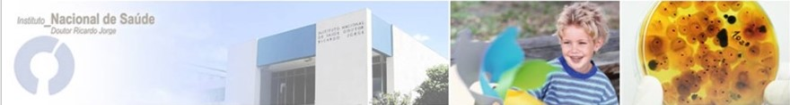
Perspectives on regulation for fungi in drinking water
João Brandão
Water and Soil Unit, Department of Environmental Health,
National Institute of Health Dr. Ricardo Jorge
Joao.brandao@insa.min-saude.pt
Notes:
My name is João Brandão and I work at the National Institute of Health. First of all, I’d like to thank the organising committee for the opportunity to be here today with Professor Segal, hoping to guide you a little bit into the world or waterborne fungal exposure, in cooperation with Drs Monika Novak-Babič, from the University of Ljubljana, Dr. Ciska Schets from the Dutch National Institute for Public Health and the Environment and Dr Raquel Sabino from the National Institute of Health of Portugal

Slide 2
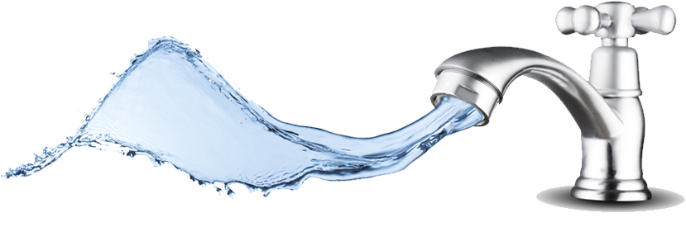
How do we get our drinking water?
Pngimg
Notes:
At home we go to the kitchen, we get a glass, run water on the tap, fill the glass and drink it. But… do you know where you water comes from? Do you have any idea of the processes involved in ensuring that you can drink that water without fearing for your health and well being the next day?

Slide 3
The water policy of the European Union
The Bathing Waters Directive (76/160/EEC) of 1976, which was replaced by the Directive 2006/7/EC
The Urban Waste Water Treatment Directive (91/271/EEC) of 21 May 1991 concerning discharges of municipal and some industrial waste waters;
The Drinking Water Directive (98/83/EC) of 3 November 1998 concerning potable water quality, in-line for an update decided in February 2018 (following European Citizens' Initiative Right2Water and aiming to contribute to the UN Sustainable development goals)
The Water Framework Directive (2000/60/EC) of 23 October 2000 concerning water resources management
Wikipedia – “Water supply and sanitation in the European Union”
Notes:
Water supply and sanitation in the European Union is the responsibility of each member state but union-wide policies have come into effect, and currently, the water policy of the European Union is primarily codified in the following directives: The Bathing Waters Directive, The Urban Waste Water Treatment Directive, The Drinking Water Directive and The Water Framework Directive.
Currently, the potable water quality, is in-line for an update decided in February 2018, following the European Citizens' Initiative Right2Water and also in order to contribute to the UN Sustainable development goals.
Other countries follow their own legislations like for example in the USA, the Safe Drinking Water Act, originally issues in 1974 and amended in 1986 and 1996.

Slide 4
Member States shall ensure that such drinking water:
Does not contain any concentration of micro-organisms, parasites or any other substance which constitutes a potential human health risk;
Meets the minimum requirements (microbiological and chemical parameters and those relating to radioactivity) laid down by the directive.
Will take any other action needed in order to guarantee the healthiness and purity of water intended for human consumption.
Wikipedia – “Drinking Water Directive 1998”
Notes:
Member States shall ensure that such drinking water:
Does not contain any concentration of micro-organisms, parasites or any other substance which constitutes a potential human health risk;
Meets the minimum requirements (microbiological and chemical parameters and those relating to radioactivity) laid down by the directive.
Will take any other action needed in order to guarantee the healthiness and purity of water intended for human consumption.

Slide 5

Drinking water comes from natural sources
Groundwater
Surface water
Storage
Distribution
Treatment
Point of use
Notes:
Therefore, potable water undergoes chemical and microbiological safety assessment and treatment, in order to remove any harmful contaminants. The whole process is defined by the following steps: (1) Collection; (2) Screening and Straining; (3) Chemical Addition; (4) Coagulation and Flocculation; (5) Sedimentation and (6) Clarification; (6) Filtration; (7) Disinfection ; (8) Storage ; (9) and finally Distribution.

Slide 6
The Drinking Water Directive applies to:
all distribution systems serving more than 50 people or supplying more than 10 cubic meter per day, but also distribution systems serving less than 50 people/supplying less than 10 cubic meter per day if the water is supplied as part of an economic activity;
drinking water from tankers;
drinking water in bottles or containers;
water used in the food-processing industry, unless the competent national authorities are satisfied that the quality of the water cannot affect the wholesomeness of the foodstuff in its finished form.
https://ec.europa.eu/environment/water/water-drink/legislation_en.html
Notes:
The Drinking Water Directive applies to:
all distribution systems serving more than 50 people or supplying more than 10 cubic meter per day, but also distribution systems serving less than 50 people/supplying less than 10 cubic meter per day if the water is supplied as part of an economic activity;
drinking water from tankers;
drinking water in bottles or containers;
water used in the food-processing industry, unless the competent national authorities are satisfied that the quality of the water cannot affect the wholesomeness of the foodstuff in its finished form.

Slide 7
The Drinking Water Directive does not apply to:
natural mineral waters recognised as such by the competent national authorities, in accordance with Council Directive 80/777/EEC of 15 July 1980 on the approximation of the laws of the Member States relating to the exploitation and marketing of natural mineral waters and repealed by Directive 2009/54/EC of 18 June 2009 on the exploitation and marketing of natural mineral waters; and
waters which are medicinal products within the meaning of Council Directive 65/65/EEC of 26 January 1965 on the approximation of provisions laid down by law, regulation or administrative action relating to medicinal products and repealed by Directive 2001/83/EC of 6 November 201 on the Community code relating to medicinal products for human use.
https://ec.europa.eu/environment/water/water-drink/legislation_en.html
Notes:
The Drinking Water Directive does not apply to:
natural mineral waters recognised as such by the competent national authorities; and
waters which are medicinal products for human use.

Slide 8
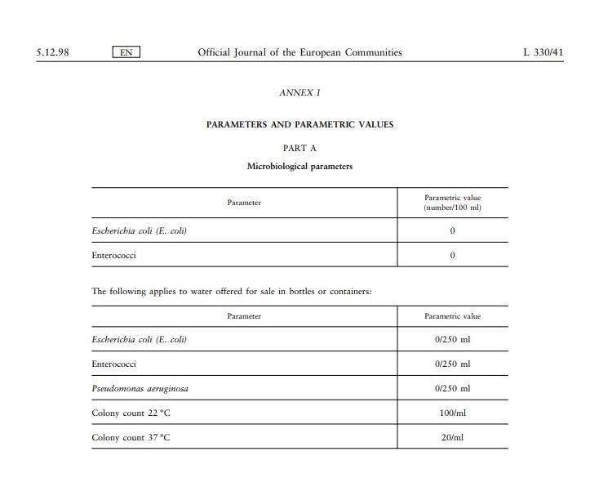
Microbiological parameters
The current directive requires the monitorisation of E. coli and Enterococci, with 0 colony forming units per 100 ml for distribution water
And above plus Pseudomonas aeruginosa, but per 250 ml for bottled or containment water. For this kind of water also colony count at 22 ºC and 37 ºC is used with the parametric limits of 100 and 20 colony forming units per ml, respectively.
Council Directive 98/83/EC of 3 November 1998 on the quality of water intended for human consumption. Official Journal of the European Communities5.12.98, L330/32–L330/53.
Notes:
The current directive requires the monitorisation of E. coli and Enterococci, with 0 colony forming units per 100 ml for distribution water
And above plus Pseudomonas aeruginosa, but per 250 ml for bottled or containment water. For this kind of water also colony count at 22 ºC and 37 ºC is used with the parametric limits of 100 and 20 colony forming units per ml, respectively.
This is considered the basic parameters, to which countries may add local ones based on their own health protection policies and epidemiological concerns. This posture opened a window to what is now considered a way forward based on Health Risk Assessment.

Slide 9

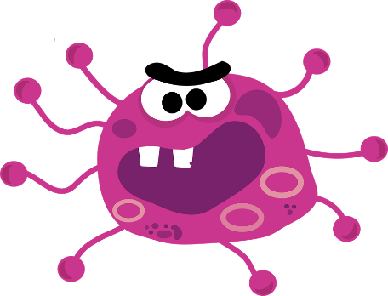

What happened to fungi?
Some integrate the total colony count at 22 and at 37 ºC but most fungi are slow growing compared to bacteria that will take up space and nutrients so they won’t show up
Seriously? Not even
one day? All gone already? Food and space?
Google Search for an illustrative image ☺ - Posted on September 7, 2016 by Norwich Radical in Inter|national
Pixabay
Notes:
But what happened to fungi? Some integrate the total colony count at 22 and at 37 ºC but most fungi are slow growing compared to bacteria that will take up space and nutrients so they won’t show up

Slide 10
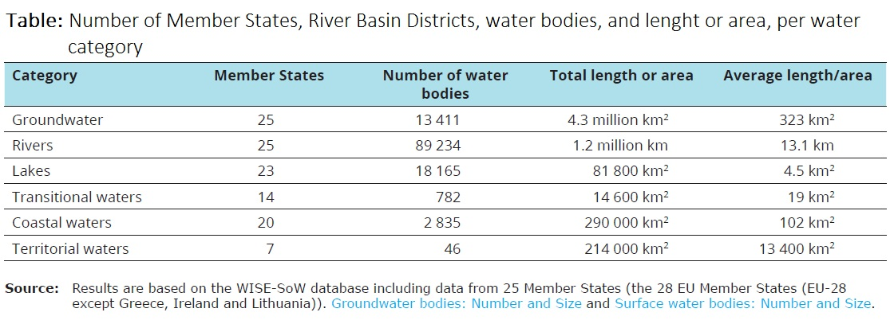
But is drinking water the only thing we should worry about? Let’s consider where we get the water from:
https://www.eea.europa.eu/themes/water/european-waters
Notes:
Look at where we can get the water from. Although, I’m not aware that we desalinate sea water to turn into drinking water in Europe for now. But with the desertification of the south of Europe and Global warming, the growing scarcity of drinking water might lead to moving in that direction, as other countries currently do, namely Israel.

Slide 11
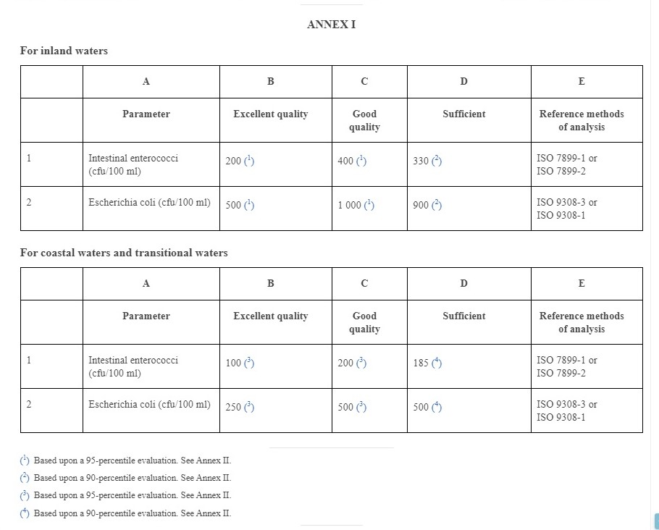
What are the parameters of bathing/recreational water?
Based on categories of Enterococci and E. coli counts per 100 ml
Tendency to move towards modeling;
No new parameters in store;
Based on WHO’s Guidelines for safe creational water environments;
HAB will need to be put in soon.
Directive 2006/7/EC of the European Parliament and of the Council of 15 February 2006 Concerning the Management of Bathing Water Quality and Repealing Directive 76/160/EEC, European Union (2006)
Notes:
Parameters of bathing/recreational water:
Are based on categories of Enterococci and E. coli counts per 100 ml
There’s a tendency to move towards modeling;
There are no new parameters in store for the review due in 2020;
Based on WHO’s Guidelines for safe creational water environments;
HAB will need to be added soon.

Slide 12

Again, no fungi! But do we need it?
Please raise one arm if you think we should include fungi in water safety regulation!
PNGfind
Notes:
Again, no fungi! But do we need it? Please raise one arm if you think we should include fungi in water safety regulation!
(COUNT HOW MANY!)

Slide 13
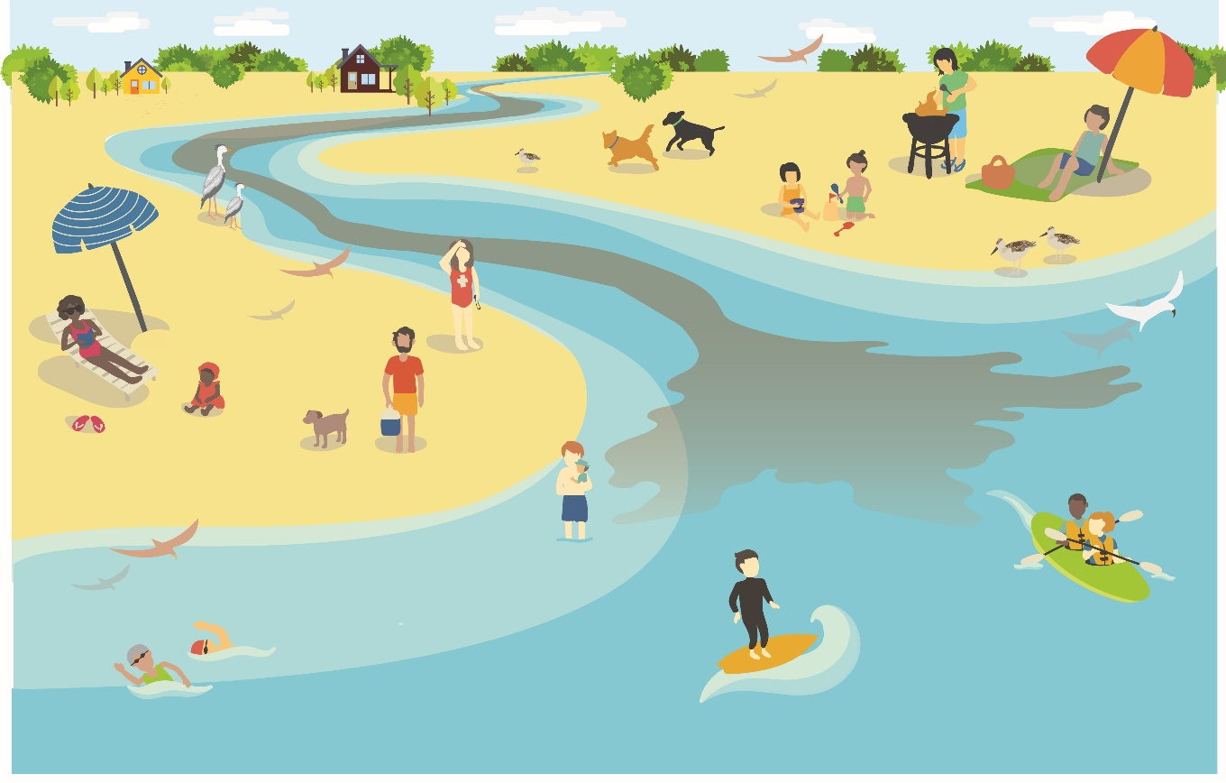
Schematic of the interactions between water masses with recreational water users, wild and domesticated life and plants. One Health!!
Weiskerger et al. 2019 “Impacts of a Changing Earth on Microbial Dynamics and Human Health Risks in the Continuum between Beach Water and Sand” Water Research
Notes:
The fecal pollution pathways are fairly well characterised. Especially since quantitative microbial risk assessment and modelling of pollution flows are being developed as means to predict the effect of exposure and waterborne propagation. We know now that sand is part of the water masses diffuse pollution equation, with run off and tide retraction and not only.

Slide 14
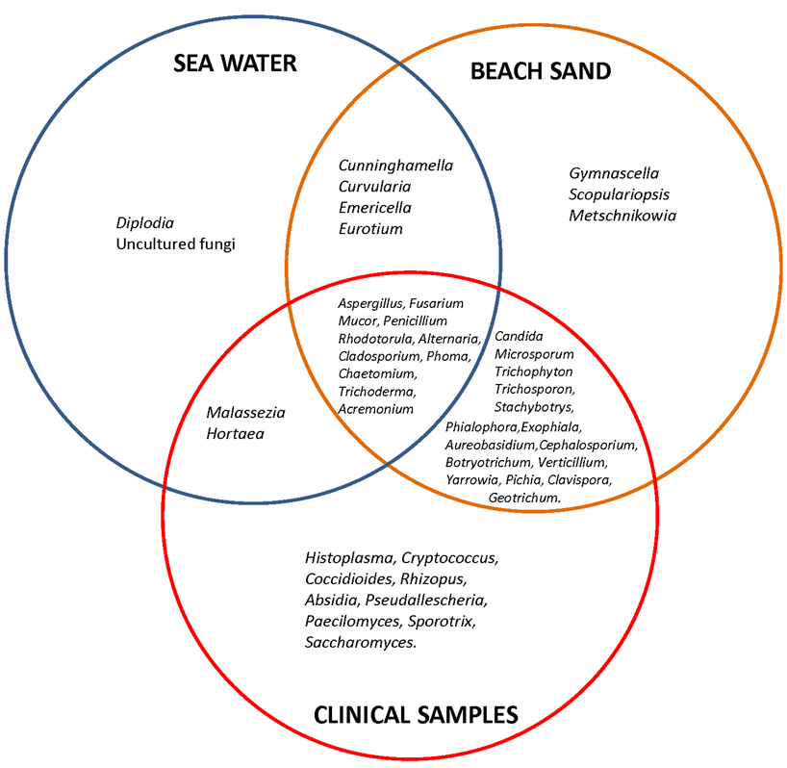
Presence of fungal genera in environmental and clinical studies
Solo-Gabriele et al. 2016 “Beach sand and the potential for infectious disease transmission: Observations and recommendations”. Journal of the Marine Biological Association of the United Kingdom
Notes:
One thing that people working with water quality rarely considered until recently, were the effects of fungi in our health. More extendedly, also the health of a whole interactive biological community, Animals and Plants included.

Slide 15

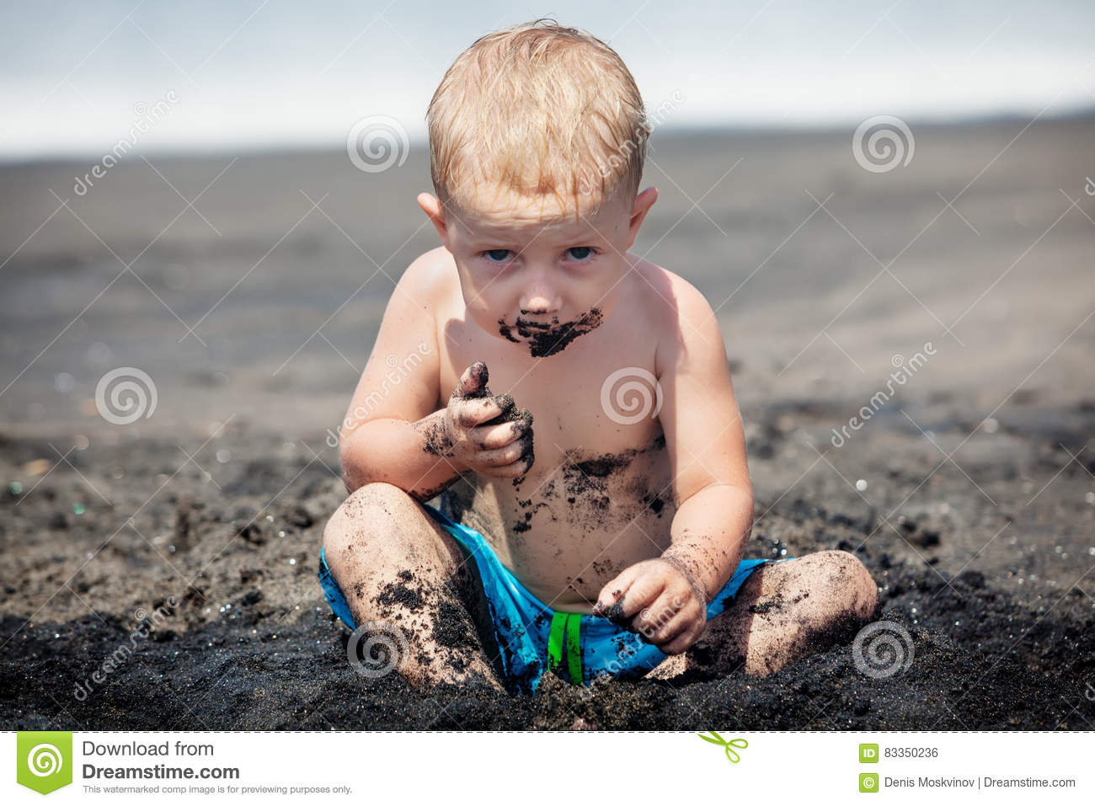
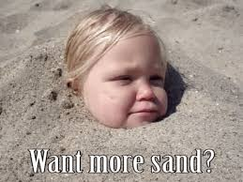
ECMM Participants in Mycosands
Name | Country
Aleksandra Barac | Serbia
Ana Sampaio | Portugal
Aristea Velegraki | Greece
Anna Maria Tortorano | Italia
Dilara Ogunc | Turkey
Emanuel Roilides | Greece
Esther Segal | Israel
Giuliana Lo Cascio | Italia (Riviera adriatica)
Gule Cinar | Turkey
Jean-Pierre Gangneux | France
Joao Brandao | Portugal
Joseph Meletiadis | Greece
Laura Trovato | Italia (Sicilia)
Lena Klingspor | Sweden
Malcolm Richardson | UK
Maria Efstratiou | Greece
Marija Kataržytė | Lithuania
Mihai Mares | Romania
Mümtaz Güran | Turkey
Nilgün Çerikçioğlu | Turkey
Nina Gunde-Cimerman | Slovenia
Salvatore C. Oliveri | Italia (Sicilia)
Salvatore Rubino | Italy (Sardinia)
Sevtap Arikan Akdagli | Turkey
Stéphane Ranque | France
Valentina Arsić Arsenijević | Serbia
Wieland Meyer | Australia
Willem Melchers | Netherlands
Wim Meijer | Ireland
Notes:
On the left you can see a list of people and countries involved in this study. On the right, one of the reasons why people got involved: protecting the health of children playing with sand.
It was an ambitious initiative and we had very little financing for it. Personal motivation was thus the driving force of this project and financing is being used for meetings calibration and reporting in open access.
However, this initiative will inform us also not only of our exposure to fungi at the beach but also what populates European inland and costal water shores that inevitably contributes for the disperse fungal flora in water and eventually our drinking water sources

Slide 16
Outline of the study
Fungal Parameters:
A. Dermatophytes – indicators of human/animal dermal contamination (including the Arthroderma insingulare complex, formerly known as Trichophyton terrestre)
Candida albicans –indicator of human fecal contamination
Allergenic fungi – Aspergillus, Penicillium and others
Total number of colonies per gram of sand
2. Geo parameters:
The target was all of Europe, sectioned by climates, geological characteristics and fresh water and seawater. A strong participation of the Mediterranean coast, where tourists tend to congregate the most during warm months.
3. Methodology:
Culture and quantification
Identification:
Phenotypic, Mass Spectral (MALDI-TOF), Molecular (ITS sequencing)
Notes:
For fungal Parameters we chose:
A. Dermatophytes – indicators of human/animal dermal contamination (including the Arthroderma insingulare complex, formerly known as Trichophyton terrestre)
B. Candida albicans – indicator of human fecal contamination
C. Allergenic fungi – Aspergillus, Penicillium for example
D. Total number of fungal colonies per gram of sand
Geo parameters:
The target was all of Europe, sectioned by climates, geological characteristics and fresh water and seawater, with a strong participation of the Mediterranean coast, where tourists tend to congregate the most during warm months.
Methods:
Culture and quantification in Sabouraud and Mycosel at 27.5 ºC and 37 ºC
Identification was done by phenotypic characteristics, Mass Spectroscopy (MALDI-TOF) and Molecular Biology (sequencing)

Slide 17
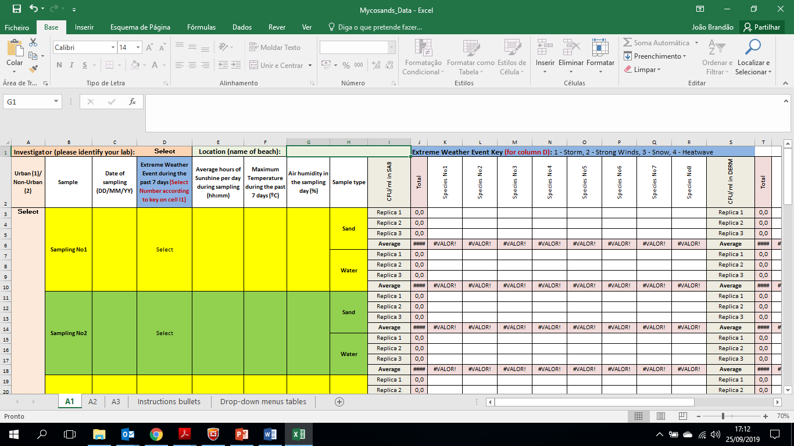

Other variables of the study
Type of beach (Urban or not)
Humidity
Hours of sunshine
Date of sampling
Maximum temperature at sampling day
Any extreme weather events during the past 7 days?
Notes:
Type of beach (Urban or not), Humidity, hours of sunshine, date of sampling, maximum temperature at sampling day, and any extreme weather events during the past 7 days?

Slide 18
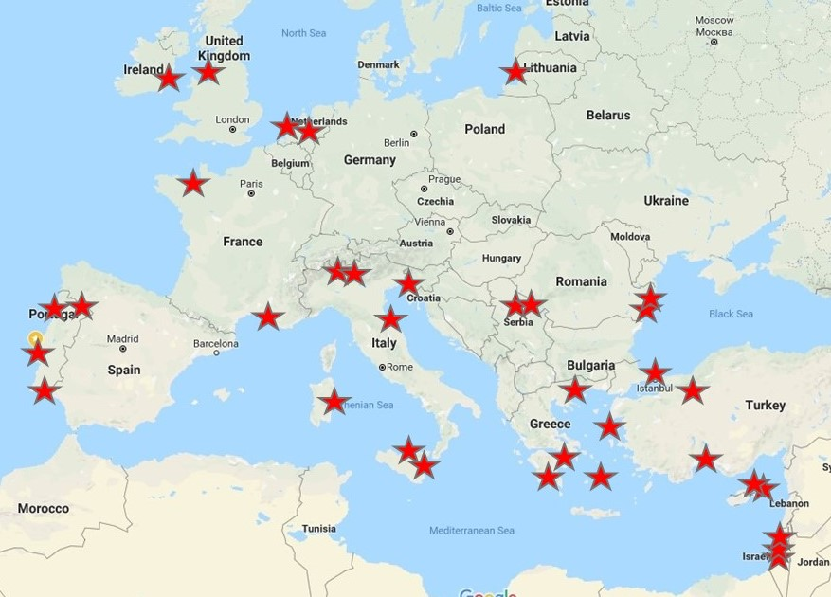
Sampling Map of Europe – Exploratory Study
North West
South West
Black Sea
Mediterranean and Adriatic Seas
Notes:
…and here you see the sites under study. In order to achieve some robustness we aggregated some of the sampling sites in 4 regions. Northwest Europe, Southwest Europe, Mediterranean and Adriatic Seas and the Black Sea. When we have all the data we may structure our analysis differently though.
In Portugal we studied two beaches of transition waters in Lisbon (Carcavelos, Cascais and Alburrica, Barreiro), one in Algarve, in the South (Praia Verde, Castro Marim), some inland beaches in Tràs-os-Montes (North East) and on the coast in the North: Matosinhos, Porto.

Slide 19
In short
Our water sources are influenced by fungi even though we don’t monitor them in quality assessment.
Fungi pose a risk for a more fragile segment of the population that can be found basically everywhere, but especially Hospitals and nursing homes
Biofilms in water distribution pipes and storage tanks may serve as an exposure reservoir distributing spores and fragments of mixed biofilms
In showers we breath aerosols
In swimming pools we bathe in whatever fungi we shed together with what came in to fill the swimming pool and that resists chlorination
Our homes get inoculated near water sources reason why the Swedish added fungal counts to their drinking water regulation
Some of the fungi that come in from underground water maintained in reservoirs produce toxins and tend to grow on our kitchen and bathroom walls
Notes:
In short, we should consider the following
Our water sources are influenced by fungi even though we don’t monitor them in quality assessment.
Fungi pose a risk for a more fragile segment of the population that can be found basically everywhere, but especially Hospitals and nursing homes
Biofilms in water distribution pipes and storage tanks may serve as an exposure reservoir distributing spores and fragments of mixed biofilms
In showers we breath aerosols
In swimming pools we bathe in whatever fungi we shed together with what came in to fill the swimming pool and that resists chlorination
Our homes get inoculated near water sources reason why the Swedish added fungal counts to their drinking water regulation
Some of the fungi that come in from underground water maintained in reservoirs produce toxins and tend to grow on our kitchen and bathroom walls

Slide 20
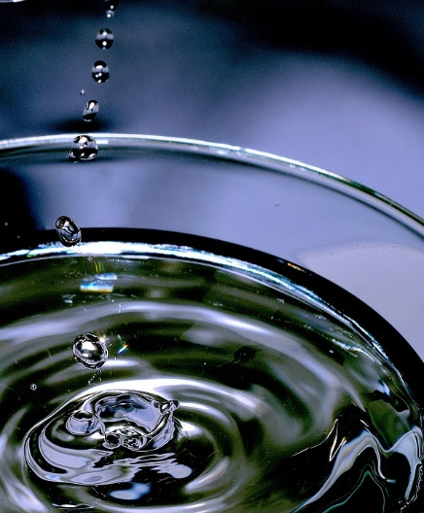
Acknowledgments
The authors of the next three communications who kindly accepted the invitation to join Prof Segal and myself in this session,
The organisation of TIMM for accomodating this session in its programme,
The entire team of the Mycosands project for generating new data on fungal contaminants of beach sand,
The European Confederation of Medical Mycology and The International Society of Human and Animal Mycology for financing Mycosands’ meetings, calibration actions and publication fees.
All of you for joining us here today.
Max Pixel
Notes:
The authors of the next three communications who kindly accepted the invitation to join Prof Segal and myself in this session,
The organisation of TIMM for accomodating this session in its programme,
The entire team of the Mycosands project for generating new data on fungal contaminants of beach sand,
The European Confederation of Medical Mycology and The International Society of Human and Animal Mycology for financing Mycosands’ meetings, calibration actions and publication fees.
I will now give the floor to my colleagues that will show you why some of us think that fungi should be included in water safety regulation

